Slide 1
The 2017 ILAE Classification of Seizures
Robert S. Fisher, MD, PhD
Maslah Saul MD Professor of Neurology
Director, Stanford Epilepsy Center
In 2017, the ILAE released a new classification of seizure types, largely based upon the existing classification formulated in 1981. Primary differences include specific listing of certain new focal seizure types that may previously only have been in the generalized category, use of awareness as a surrogate for consciousness, emphasis on classifying focal seizures by the first clinical manifestation (except for altered awareness), a few new generalized seizure types, ability to classify some seizures when onset is unknown, and renaming of certain terms to improve clarity of meaning.
The attached PowerPoint slide set may be used without need to request permission for any non-commercial educational purpose meeting the usual "fair use" requirements. Permission from robert.fisher@stanford.edu is however required to use any of the slides in a publication or for commercial use. When using the slides, please attribute them to Fisher et al. Instruction manual for the ILAE 2017 operational classification of seizure types. Epilepsia doi: 10.1111/epi.13671.

Slide 2
ILAE 2017 Classification of Seizure Types Basic Version ¹
Focal Onset
Generalized Onset
Unknown Onset
Aware
Impaired
Awareness
Motor
Tonic-clonic
Other motor
Non-Motor (Absence)
Motor
Tonic-clonic
Other motor
Non-Motor
Motor
Non-Motor
Unclassified ²
focal to bilateral tonic-clonic
¹ Definitions, other seizure types and descriptors are listed in the accompanying paper & glossary of terms
² Due to inadequate information or inability to place in other categories
From Fisher et al. Instruction manual for the ILAE 2017 operational classification of seizure types. Epilepsia doi: 10.1111/epi.13671

Slide 3
ILAE 2017 Classification of Seizure Types Expanded Version¹
Focal Onset
Generalized Onset
Unknown Onset
Aware
Impaired
Awareness
Motor
tonic-clonic
clonic
tonic
myoclonic
myoclonic-tonic-clonic
myoclonic-atonic
atonic
epileptic spasms²
Non-Motor (absence)
typical
atypical
myoclonic
eyelid myoclonia
Motor
tonic-clonic
epileptic spasms
Non-Motor
behavior arrest
Motor Onset
automatisms
atonic²
clonic
epileptic spasms²
hyperkinetic
myoclonic
tonic
Non-Motor Onset
autonomic
behavior arrest
cognitive
emotional
sensory
Unclassified³
¹ Definitions, other seizure types and descriptors are listed in the
accompanying paper and glossary of terms.
² These could be focal or generalized, with or without alteration of awareness
³ Due to inadequate information or inability to place in other categories
focal to bilateral tonic-clonic
From Fisher et al. Instruction manual for the ILAE 2017 operational classification of seizure types. Epilepsia doi: 10.1111/epi.13671

Slide 4
INTERNATIONAL CLASSIFICATION OF SEIZURES 1981
  Partial Seizures (start in one place)
      Simple (no loss of consciousness of memory)
  Sensory
  Motor
  Sensory-Motor
  Psychic (abnormal thoughts or perceptions)
  Autonomic (heat, nausea, flushing, etc.)
  Complex (consciousness or memory impaired)
  With or without aura (warning)
  With or without automatisms
  Secondarily generalized
  Generalized Seizures (apparent start over wide areas of brain)
  Absence (petit mal)
  Tonic-clonic (grand mal)
  Atonic (drop seizures)
  Myoclonic
  Other
  Unclassifiable seizures
Dreifuss et al. Proposal for revised clinical and electroencephalographic classification of epileptic seizures. From the Commission on Classification and Terminology of the International League Against Epilepsy. Epilepsia. 1981;22:489-501.

Slide 5
Motivation for Revision
Some seizure types, for example tonic seizures or epileptic spasms, can have either a focal or generalized onset.
Lack of knowledge about the onset makes a seizure unclassifiable and difficult to discuss with the 1981 system.
Retrospective seizure descriptions often do not specify a level of consciousness, and altered consciousness, while central to many seizures, is a confusing concept.
Some terms in current use do not have high levels of community acceptance or public understanding, such as “psychic,” “partial,” “simple partial,” “complex partial”, and “dyscognitive.”
Some important seizure types are not included.

Slide 6
Possible Seizure Classifications Could be Based On:
Pathophysiology
But this is
currently
impossible with
our limited
understanding
Anatomy
Temporal
Frontal
Parietal
Occipital
Diencephalic
Brainstem
Networks
Neocortical
Limbic
Thalamo-Cortical
Brainstem
Practical, by:
AED response
Surgical target
Disabling
EEG pattern
Many others
Modify Existing
1981 ILAE System
2010 ILAE update
In the absence of fundamental knowledge, ILAE chose to extend the existing classification
The is an operational (practical) system, not a true scientific classification
Others might devise special operational classifications for specific use, e.g., neonatal, ICU
This classification is predominantly for clinicians

Slide 7
How Do Clinicians Classify Seizures ?
Elicit symptoms and signs of event (semiology)
Look for familiar patterns in symptoms and signs
Sometimes use ancillary data, e.g., EEG, MRI, genes, antibodies, etc.
one-to many
Symptoms + Signs
Seizure Type
many-to-one
examples
focal impaired awareness seizure
automatisms
absence seizure
automatisms
focal impaired awareness seizure
autonomic

Slide 8
Key Seizure Signs and Symptoms?
Symptoms | Medical Term
automatic behaviors | automatisms
emotions or appearance of emotions | emotions
extension or flexion postures | tonic
flushing/sweating/piloerection | autonomic
jerking arrhythmically | myoclonus
jerking rhythmically | clonus
language or thinking problems, deja vu | cognitive
lid jerks | eyelid myoclonia
limp | atonic
numb/tingling, sounds, smells, tastes visions, vertigo | sensations
pausing, freezing, activity arrest | behavior arrest
thrashing/pedaling | hyperkinetic
trunk flexion | spasm

Slide 9
The Elements of Change
Allow some seizures to be either focal or generalized onset
Classify seizures of unknown onset
Clarify “impairment of consciousness”
Include a few previously unclassified types
Update word usage for greater public clarity
Validate use of supportive information, e.g. EEG
Conform with ICD 11 and 12
Update the 2001 glossary of seizure terms
Standardize common descriptors to describe seizures
Map old to new terms

Slide 10
The Elements of Change
Allow some seizures to be either focal or generalized onset
Classify seizures of unknown onset
Clarify “impairment of consciousness”
Include a few previously unclassified types
Update word usage for greater public clarity
Validate use of supportive information, e.g. EEG
Conform with ICD 11 and 12
Update the 2001 glossary of seizure terms
Standardize common descriptors to describe seizures
Map old to new terms

Slide 11
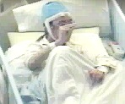
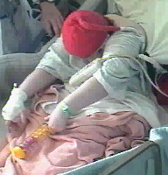
Some Seizure Onsets can be Focal or Generalized
Focal Onset
Generalized Onset
atonic
atonic
clonic
clonic
epileptic spasms
epileptic spasms
myoclonic
myoclonic
tonic
tonic
tonic-clonic
tonic-clonic

Slide 12
The Elements of Change
Allow some seizures to be either focal or generalized onset
Classify seizures of unknown onset
Clarify “impairment of consciousness”
Include a few previously unclassified types
Update word usage for greater public clarity
Validate use of supportive information, e.g. EEG
Conform with ICD 11 and 12
Update the 2001 glossary of seizure terms
Standardize common descriptors to describe seizures
Map old to new terms

Slide 13
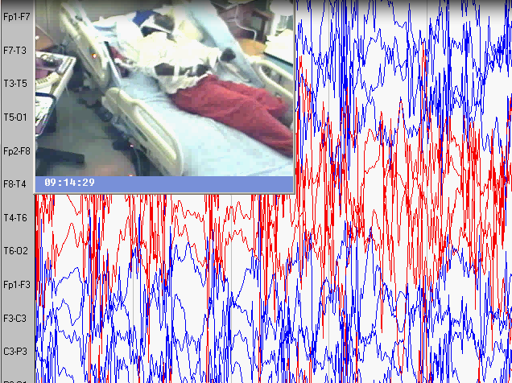
Seizures of Unknown Onset
Hypothetical case: You hear a noise and enter the video-EEG room to find the patient in bed, grunting, eyes rolled up, all limbs stiff, then rhythmically jerking for a minute. He was off-camera at the start. What seizure type is this?
Some seizure types are worth describing even if onset is unknown:
tonic-clonic
epileptic spasms
behavior arrest

Slide 14
The Elements of Change
Allow some seizures to be either focal or generalized onset
Classify seizures of unknown onset
Clarify “impairment of consciousness”
Include a few previously unclassified types
Update word usage for greater public clarity
Validate use of supportive information, e.g. EEG
Conform with ICD 11 and 12
Update the 2001 glossary of seizure terms
Standardize common descriptors to describe seizures
Map old to new terms

Slide 15
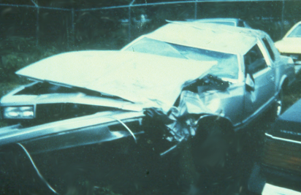
Key Role of Impaired Consciousness
Among many possible behaviors during a seizure, impairment of consciousness has always had a key
role in classifying the seizure, because of practical
importance for:
Driving
Safety during seizures
Employability
Interference with schooling and learning

Slide 16

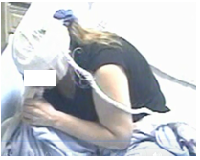
Loss (or Impairment) of Consciousness
Two types of seizures with loss of consciousness
How well does the public understand LOC during a complex partial seizure?

Slide 17
Loss (or Impairment) of Consciousness
Elements of consciousness
Awareness of ongoing activities
Memory for time during the event
Responsiveness to verbal or nonverbal stimuli
Sense of self as being distinct from others
Which would be the best surrogate marker ?
The 2017 Classification chooses awareness
Consciousness remains in the classification
but “awareness” is in the seizure name
In several languages, these words are the same
Awareness is not used to classify generalized onset seizures

Slide 18
The Elements of Change
Allow some seizures to be either focal or generalized onset
Classify seizures of unknown onset
Clarify “impairment of consciousness”
Include a few previously unclassified types
Update word usage for greater public clarity
Validate use of supportive information, e.g. EEG
Conform with ICD 11 and 12
Update the 2001 glossary of seizure terms
Standardize common descriptors to describe seizures
Map old to new terms

Slide 19
New Seizure Types
New Focal Seizures
New generalized seizures
absence with eyelid myoclonia
epileptic spasms (infantile spasms)
myoclonic-atonic (e.g., Doose)
myoclonic-tonic-clonic (e.g., JME)
Motor
atonic
automatisms
clonic
epileptic spasms
hyperkinetic
myoclonic
tonic
Non-Motor
behavior arrest
(autonomic)
(cognitive)
emotional
(sensory)
New combined seizures
(focal to bilateral tonic-clonic)
(parentheses) indicates prior existence, but renaming

Slide 20
The Elements of Change
Allow some seizures to be either focal or generalized onset
Classify seizures of unknown onset
Clarify “impairment of consciousness”
Include a few previously unclassified types
Update word usage for greater public clarity
Validate use of supportive information, e.g. EEG
Conform with ICD 11 and 12
Update the 2001 glossary of seizure terms
Standardize common descriptors to describe seizures
Map old to new terms

Slide 21
Wording Changes
O L D T E R M | N E W T E R M
Unconscious (still used, not in name) | Impaired awareness (surrogate)
Partial | Focal
Simple partial | Focal aware
Complex partial | Focal impaired awareness
Dyscognitive (word discontinued) | Focal impaired awareness
Psychic | Cognitive
Secondarily generalized tonic-clonic | Focal to bilateral tonic-clonic
Arrest, freeze, pause, interruption | Behavior arrest

Slide 22
The Elements of Change
Allow some seizures to be either focal or generalized onset
Classify seizures of unknown onset
Clarify “impairment of consciousness”
Include a few previously unclassified types
Update word usage for greater public clarity
Validate use of supportive information, e.g. EEG
Conform with ICD 11 and 12
Update the 2001 glossary of seizure terms
Standardize common descriptors to describe seizures
Map old to new terms

Slide 23
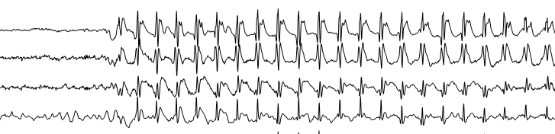
Supportive Information
Seizures are usually classified by symptoms and signs
But supportive information may be helpful, when available:
Videos brought in by family
EEG patterns
Lesions detected by neuroimaging
Laboratory results such as detection of anti-neuronal antibodies
Gene mutations
Diagnosis of an epilepsy syndrome diagnosis

Slide 24
The Elements of Change
Allow some seizures to be either focal or generalized onset
Classify seizures of unknown onset
Clarify “impairment of consciousness”
Include a few previously unclassified types
Update word usage for greater public clarity
Validate use of supportive information, e.g. EEG
Conform with ICD 11 and 12
Update the 2001 glossary of seizure terms
Standardize common descriptors to describe seizures
Map old to new terms

Slide 25
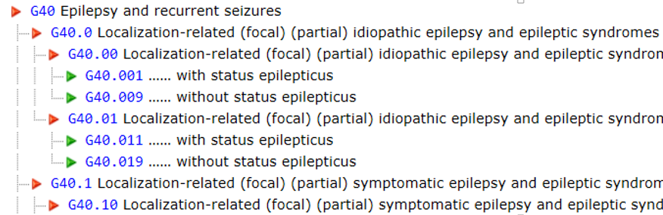
ICD9, 10, 11, 12
ICD 9 & 10 are in use now with old terminology: petit mal, grand mal
ICD 11 does not name seizure types, but ILAE syndromes and etiologies
ICD 12 should conform to the new ILAE seizure type classification

Slide 26
The Elements of Change
Allow some seizures to be either focal or generalized onset
Classify seizures of unknown onset
Clarify “impairment of consciousness”
Include a few previously unclassified types
Update word usage for greater public clarity
Validate use of supportive information, e.g. EEG
Conform with ICD 11 and 12
Update the 2001 glossary of seizure terms
Standardize common descriptors to describe seizures
Map old to new terms

Slide 27
Glossary: Full list in Epilepsia Paper
WORD | DEFINITION | SOURCE
absence, typical | a sudden onset, interruption of ongoing activities, a blank stare, possibly a brief up- ward deviation of the eyes. Usually the patient will be unresponsive when spoken to. Duration is a few seconds to half a minute with very rapid recovery. Although not always available, an EEG would show generalized epileptiform discharges during the event. An absence seizure is by definition a seizure of generalized onset. The word is not synonymous with a blank stare, which also can be encountered with focal onset seizures. | Adapted from ¹¹
absence, atypical | an absence seizure with changes in tone that are more pronounced than in typical absence or the onset and/or cessation is not abrupt, often associated with slow, irregular, generalized spike-wave activity | Adapted from Dreifuss ¹
arrest | see behavioral arrest | new
atonic | sudden loss or diminution of muscle tone without apparent preceding myoclonic or tonic event lasting ~1 to 2 s, involving head, trunk, jaw, or limb musculature. | ¹¹
automatism | a more or less coordinated motor activity usually occurring when cognition is impaired and for which the subject is usually (but not always) amnesic afterward. This often resembles a voluntary movement and may consist of an inappropriate continuation of preictal motor activity. | ¹¹

Slide 28
The Elements of Change
Allow some seizures to be either focal or generalized onset
Classify seizures of unknown onset
Clarify “impairment of consciousness”
Include a few previously unclassified types
Update word usage for greater public clarity
Validate use of supportive information, e.g. EEG
Conform with ICD 11 and 12
Update the 2001 glossary of seizure terms
Standardize common descriptors to describe seizures
Map old to new terms

Slide 29
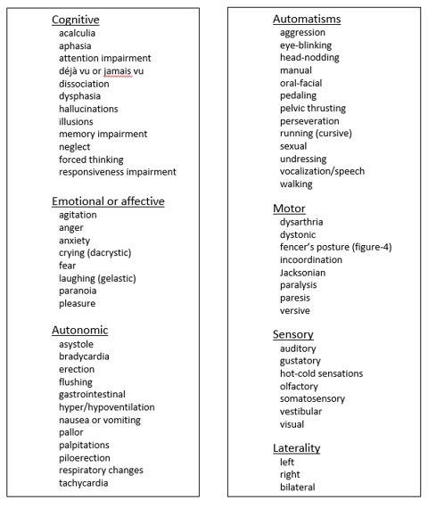
Common Descriptors
of other symptoms
and signs during
seizures.
These are not seizure
types, just suggested
descriptive words.
A free text description
is also highly encouraged.

Slide 30
The Elements of Change
Allow some seizures to be either focal or generalized onset
Classify seizures of unknown onset
Clarify “impairment of consciousness”
Include a few previously unclassified types
Update word usage for greater public clarity
Validate use of supportive information, e.g. EEG
Conform with ICD 11 and 12
Update the 2001 glossary of seizure terms
Standardize common descriptors to describe seizures
Map old to new terms

Slide 31
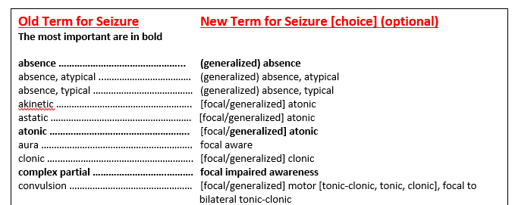
Examples of Mapping Old to New Terms
Full List in Epilepsia paper

Slide 32
Rules for Classifying Seizures (1 of 2)
Onset: Decide whether seizure onset is focal or generalized, using an 80% confidence level.
Awareness: For focal seizures, decide whether to classify by degree of awareness or to omit awareness as a classifier.
Impaired awareness at any point: A focal seizure is a focal impaired awareness seizure if awareness is impaired at any point during the seizure.
Onset predominates: Classify a focal seizure by its first prominent sign or symptom. Do not count transient behavior arrest.
Behavior arrest: A focal behavior arrest seizure shows arrest of behavior as the prominent feature of the entire seizure.
Motor/Non-motor: A focal aware or impaired awareness seizure maybe further sub-classified by motor or non-motor characteristics. Alternatively, a focal seizure can be characterized by motor or non-motor characteristics, without specifying level of awareness. Example, a focal tonic seizure.

Slide 33
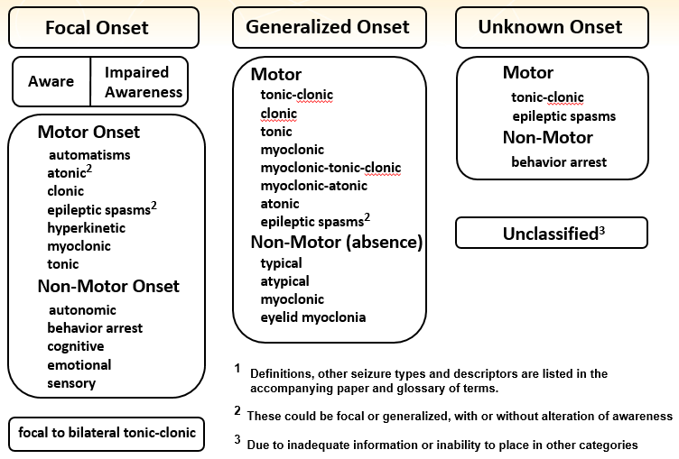
Rules for Classifying Seizures (2 of 2)
Optional terms: Terms such as motor or non-motor may be omitted when the seizure type is otherwise unambiguous.
Additional descriptors: It is encouraged to add descriptions of other signs and symptoms, suggested descriptors or free text. These do not alter the seizure type. Example: focal emotional seizure with tonic right arm activity and hyperventilation.
Bilateral vs. generalized: Use the term “bilateral” for tonic-clonic seizures that propagate to both hemispheres and “generalized” for seizures that apparently originate simultaneously in both.
Atypical absence: Absence is atypical if it has slow onset or offset, marked changes in tone or EEG spike-waves at less than 3 per second.
Clonic vs. myoclonic: Clonic refers to sustain rhythmical jerking and myoclonic to a regular unsustained jerking.
Eyelid myoclonia: Absence with eyelid myoclonia refers to forced upward jerking of the eyelids during an absence seizure.

Slide 34
The Net Effect
The net effect of updating the Classification of Seizures should be the following:
Render the choice of a seizure type easier for seizures that did not fit into any prior categories;
Clarify what is meant when a seizure is said to be of a particular type;
Provide more transparency of terminology to the nonmedical community.

Slide 35
Examples
1. A woman awakens to find her husband having a seizure in bed. The onset is not witnessed, but she is able to describe bilateral stiffening followed by bilateral shaking. EEG and MRI are normal.

Slide 36
Examples
Old = unclassified
New = unknown onset tonic-clonic
1. A woman awakens to find her husband having a seizure in bed. The onset is not witnessed, but she is able to describe bilateral stiffening followed by bilateral shaking. EEG and MRI are normal. This seizure is classified as onset unknown tonic-clonic. There is no supplementary information to determine if the onset was focal or generalized. In the old classification, this seizure would have been unclassifiable.

Slide 37
Examples
2. In an alternate scenario of case #1, the EEG shows a clear right parietal slow wave focus. The MRI shows a right parietal region of cortical dysplasia.

Slide 38
Examples
Old = partial onset, secondarily generalized seizure
New = focal to bilateral tonic-clonic seizure
2. In an alternate scenario of case #1, the EEG shows a clear right parietal slow wave focus. The MRI shows a right parietal region of cortical dysplasia. In this circumstance, the seizure can be classified as focal to bilateral tonic-clonic, despite the lack of an observed onset, because a focal etiology has been identified, and the overwhelming likelihood is that the seizure had a focal onset. The old classification would have classified this seizure as partial onset, secondarily generalized seizure.

Slide 39
Examples
3. A child is diagnosed with Lennox-Gastaut syndrome of unknown etiology. EEG shows runs of slow spike-wave. Seizure types include absence and others.

Slide 40
Examples
Old = atypical absence seizures
New = atypical absence seizures
3. A child is diagnosed with Lennox-Gastaut syndrome of unknown etiology. EEG shows runs of slow spike-wave. Seizure types with this child include absence, tonic, and focal motor seizures. In this case, the absence seizures are classified as atypical absence (the word “generalized” may be assumed) due to the EEG pattern and underlying syndrome. The absence seizures would have had the same classification in the old system.

Slide 41
Examples
4. The same child as in #3 has seizures with stiffening of the right arm and leg, during which responsiveness and awareness are retained.

Slide 42
Examples
Old = tonic seizures
New = focal aware tonic seizures
4. The same child as in #3 has seizures with stiffening of the right arm and leg, during which responsiveness and awareness are retained. This seizure is a focal aware tonic seizures (the word “motor” can be assumed). In the old system, the seizures would have been called tonic seizures, with a perhaps incorrect assumption of generalized onset.

Slide 43
Examples
5: A 25 year old woman describes seizures beginning with 30 seconds of an intense feeling that “familiar music is playing.” She can hear other people talking, but afterwards realizes that she could not determine what they were saying. After an episode, she is mildly confused, and has to “reorient herself.”

Slide 44
Examples
Old = complex partial seizures
New = focal seizures with impaired awareness
5: A 25 year old woman describes seizures beginning with 30 seconds of an intense feeling that “familiar music is playing.” She can hear other people talking, but afterwards realizes that she could not determine what they were saying. After an episode, she is mildly confused, and has to “reorient herself.” The seizures would be classified as focal seizures with impaired awareness. Even though the patient is able to interact with her environment, she cannot interpret her environment, and is mildly confused.

Slide 45
Examples
6. A 22 year-old man has seizures during which he remains fully aware, with the “hair on my arms standing on edge” and a feeling of being flushed.

Slide 46
Examples
Old = simple partial autonomic seizures
New = focal aware autonomic seizures
6. A 22 year-old man has seizures during which he remains fully aware, with the “hair on my arms standing on edge” and a feeling of being flushed. These are classified as focal aware non-motor autonomic, or more succinctly focal aware autonomic. The old classification would have called them simple partial autonomic seizures.

Slide 47
Examples
7. A 4 year-old boy with myoclonic-atonic epilepsy (Doose syndrome) has seizures with a few arm jerks, then a limp drop to the ground.

Slide 48
Examples
Old = myoclonic astatic seizures
New = myoclonic-atonic seizures
7. A 4 year-old boy with myoclonic-atonic epilepsy (Doose syndrome) has seizures with a few arm jerks, then a limp drop to the ground. These are now classified as myoclonic-atonic seizures (the word “generalized” may be assumed). The old classification would have called these unclassified or unofficially, myoclonic-astatic seizures.

Slide 49
Examples
8. A 35 year-old man with juvenile myoclonic epilepsy has seizures beginning with a few bilateral arm jerks, followed by stiffening of all limbs and then rhythmic jerking of all limbs.

Slide 50
Examples
Old = myoclonic seizures followed by a tonic-clonic seizure
New = myoclonic-tonic-clonic seizures
8. A 35 year-old man with juvenile myoclonic epilepsy has seizures beginning with a few regularly-spaced jerks, followed by stiffening of all limbs and then rhythmic jerking of all limbs. This would be classified as generalized myoclonic-tonic-clonic seizures. No corresponding single seizure type existed in the old classification, but they might have been called myoclonic seizures followed by a tonic-clonic seizure.

Slide 51
Examples
9. A 14-month old girl has sudden flexion of both arms with head flexing forward for about 2 seconds. These seizures repeat in clusters. EEG shows hypsarrhythmia with bilateral spikes, most prominent over the left parietal region. MRI shows a left parietal dysplasia.

Slide 52
Examples
Old = infantile spasms (focality not specified)
New = focal epileptic spasms
9. A 14-month old girl has sudden flexion of both arms with head flexing forward for about 2 seconds. These seizures repeat in clusters. EEG shows hypsarrhythmia with bilateral spikes, most prominent over the left parietal region. MRI shows a left parietal dysplasia. Because of the ancillary information, the seizure type would be considered to be focal epileptic spasms (the term “motor” can be assumed). The previous classification would have called them infantile spasms, with information on focality not included.

Slide 53
Examples
10. A 75 year-old man reports an internal sense of body trembling. No other information is available.

Slide 54
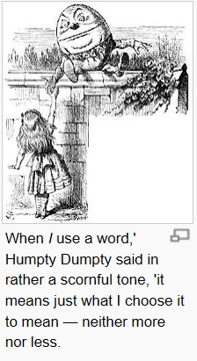
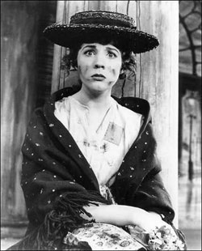
The End
“Words, words, words, I’m so sick of words!”
Eliza Doolittle, My Fair Lady

